Slide 1
The Checklist
Slideshop-2014
INTRODUCTION TO PROGRAMMING && JAVA FUNDAMENTALS

Slide 2
CHECKLIST - HEXADECIMAL
INTRODUCTION TO PROGRAMMING
Hexadecimal refers to the base-16 number system, which consists of 16 unique symbols, in contrast to the ten unique symbols of the commonly used decimal (i.e., base 10) numbering system.
The hexadecimal system is commonly used by programmers to describe locations in memory because it can represent every byte (i.e., eight bits) as two consecutive hexadecimal digits instead of the eight digits that would be required by binary (i.e., base 2) numbers
Hexadecimal numbers are indicated by the addition of either an 0x prefix or an h suffix. For example, the hexadecimal number 0x2F5B translates to the binary number 0010 1111 0101 1011.
A common use of hexadecimal numbers is to describe colors on web pages. Each of the three primary colors (i.e., red, green and blue) is represented by two hexadecimal digits to create 255 possible values, thus resulting in more than 16 million possible colors. Example: <body bgcolor="#FF0000">

Slide 3
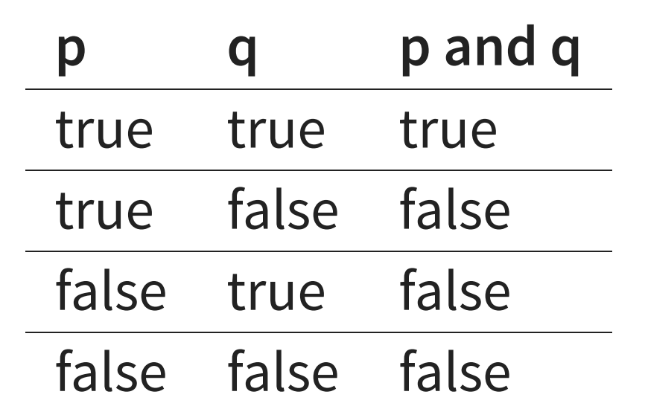
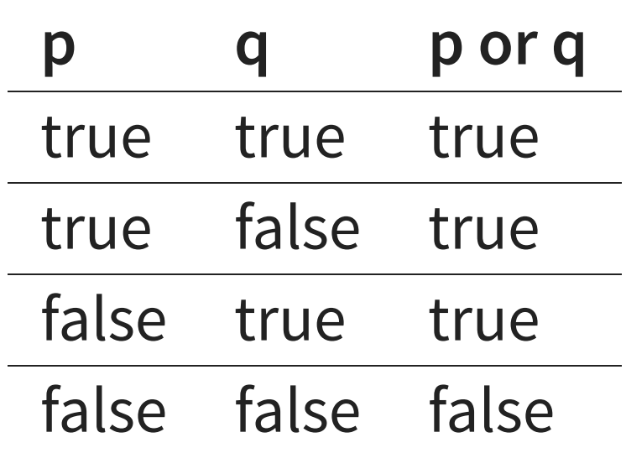
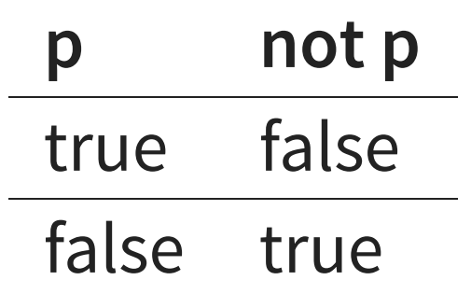
CHECKLIST – LOGICAL OPERATORS
INTRODUCTION TO PROGRAMMING
The concept of logical operators is simple. They allow a program to make a decision based on
multiple conditions. Each operand is considered a condition that can be evaluated to a
true or false value.
They are used in if conditions also in while or for loops.

Slide 4
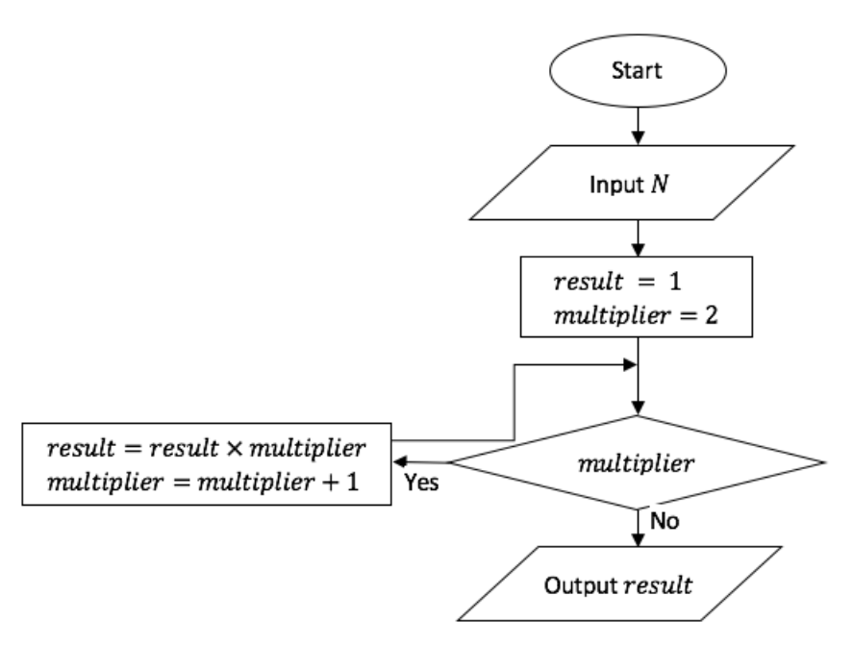
CHECKLIST - FLOWCHARTS
INTRODUCTION TO PROGRAMMING
One tool to consider is a flowchart, which is a pictorial or graphical representation of a process. ... The purpose of flowcharts are to communicate how a process works or should work without any confusing technical jargon.

Slide 5
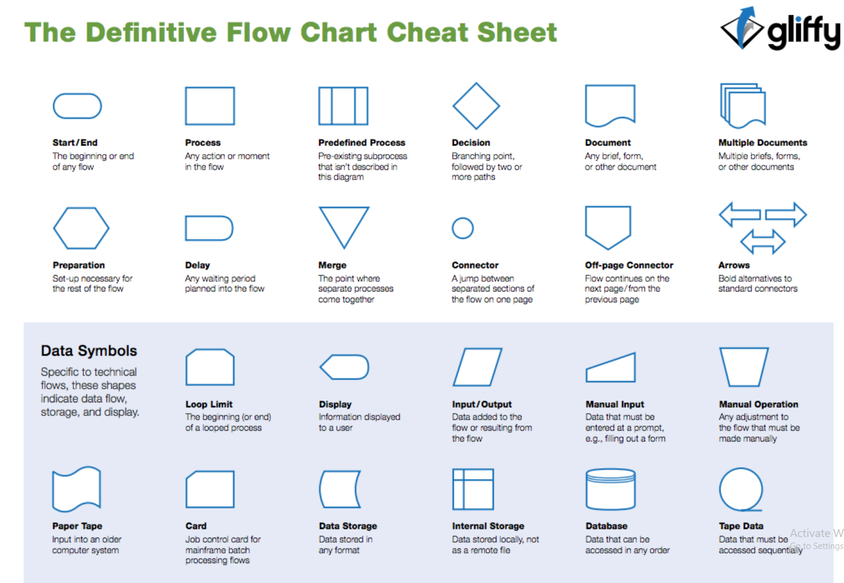
CHECKLIST - FLOWCHARTS
INTRODUCTION TO PROGRAMMING

Slide 6
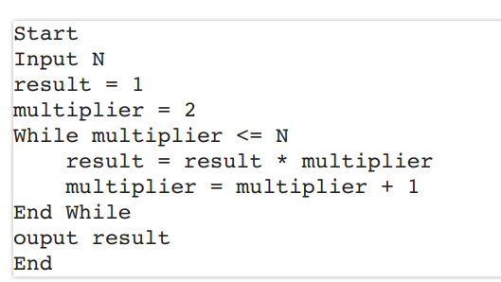
CHECKLIST - PSEUDOCODE
INTRODUCTION TO PROGRAMMING
Pseudocode is an informal high-level description of the operating principle of a computer program or other algorithm. It uses the structural conventions of a normal programming language, but is intended for human reading rather than machine reading.
*Flowcharts are mostly used in business life. In case of complex decision makings flowchart can easy your life by having a visual decision map*

Slide 7
CHECKLIST - CHARACTER ENCODING
INTRODUCTION TO PROGRAMMING
If you’re used to writing programs in other languages, you may be aware of something called ASCII Character Encoding.
Most languages use ASCII; Java uses Unicode.
In the old ASCII representation, each character takes up only 8 bits, but in Unicode, each character takes up 8, 16, or 32 bits.
ASCII stores the letters of the familiar Roman (English) alphabet, Unicode has room for characters from most of the world’s commonly spoken languages.

Slide 8
CHECKLIST - CHARACTER ENCODING
INTRODUCTION TO PROGRAMMING
UTF-8 is a method for encoding Unicode characters using 8-bit sequences.
Main difference between UTF-8, UTF-16 and UTF-32 character encoding is how many bytes it require to represent a character in memory.
UTF-8 uses minimum one byte
UTF-16 uses minimum 2 bytes
UTF-32 is fixed width encoding scheme and always uses 4 bytes to encode a Unicode code point.
Now, let's start with what is character encoding and why it's important?
Well, character encoding is an important concept in process of converting byte streams into characters, which can be displayed.
There are two things, which are important to convert bytes to characters, a character set and an encoding.
Since there are so many characters and symbols in the world, a character set is required to support all those characters. A character set is nothing but list of characters, where each symbol or character is mapped to a numeric value, also known as code points.

Slide 9
CHECKLIST - CHARACTER ENCODING
INTRODUCTION TO PROGRAMMING
On the other hand UTF-16, UTF-32 and UTF-8 are encoding schemes, which describe how these values (code points) are mapped to bytes (using different bit values as a basis; e.g. 16-bit for UTF-16, 32 bits for UTF-32 and 8-bit for UTF-8).
For example, for character A, which is Latin Capital A, Unicode code point is U+0041, UTF-8 encoded bytes are 41, UTF-16 encoding is 0041 and Java char literal is '\u0041'.
In short, you must need a character encoding scheme to interpret stream of bytes, in the absence of character encoding, you cannot show them correctly.
Java programming language has extensive support for different charset and character encoding, by default it use UTF-8.

Slide 10
CHECKLIST - CHARACTER ENCODING
INTRODUCTION TO PROGRAMMING
UTF-8 has an advantage where ASCII are most used characters, in that case most characters only need one byte.
UTF-8 file containing only ASCII characters has the same encoding as an ASCII file, which means English text looks exactly the same in UTF-8 as it did in ASCII.
Given dominance of ASCII in past this was the main reason of initial acceptance of Unicode and UTF-8.

Slide 11
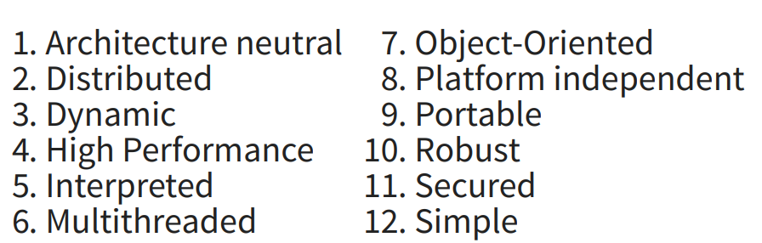
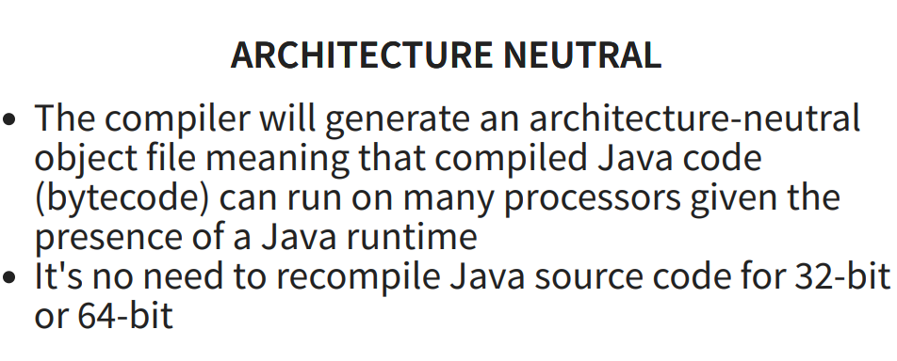
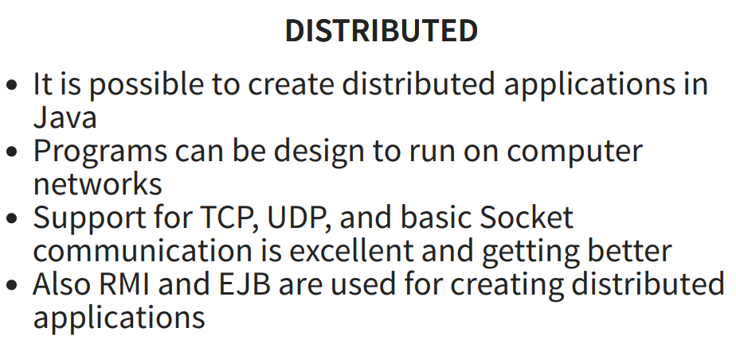
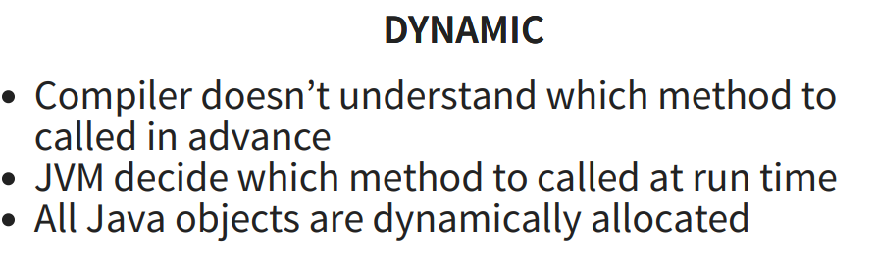
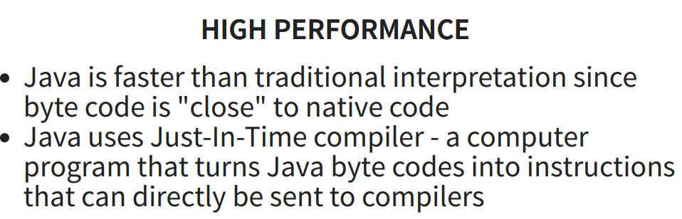
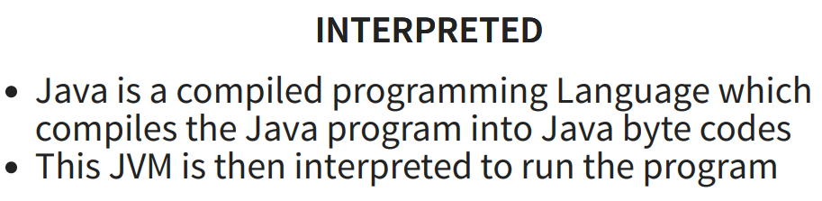
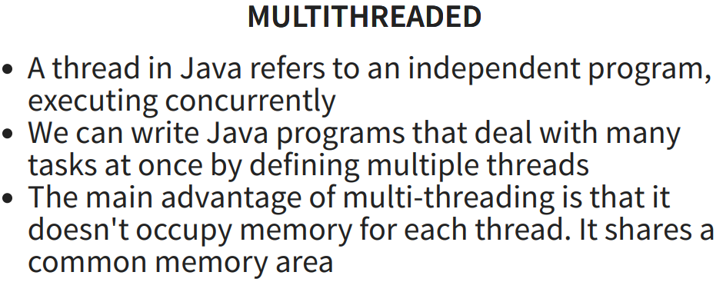
CHECKLIST - ABOUT JAVA
JAVA FUNDAMENTALS

Slide 12
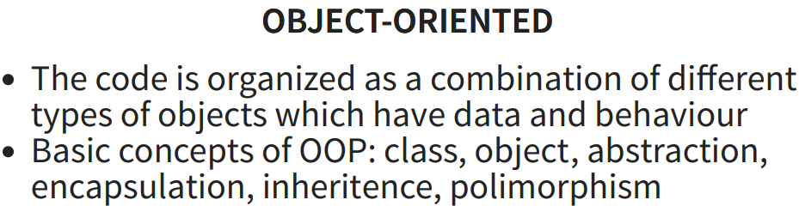
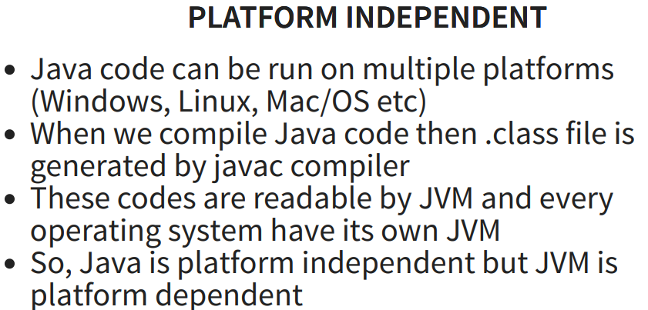
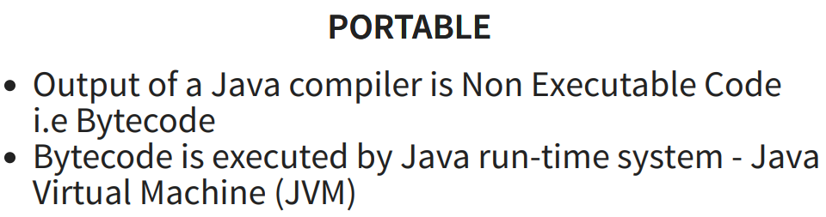
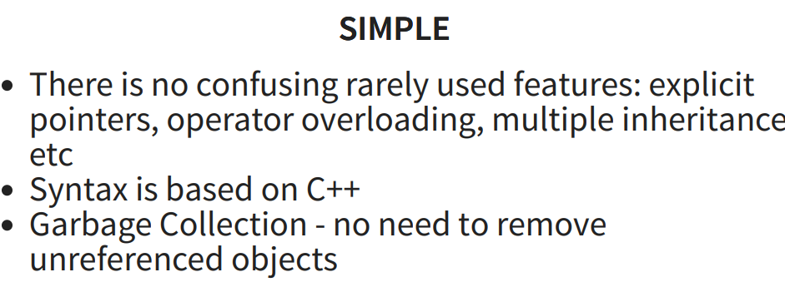
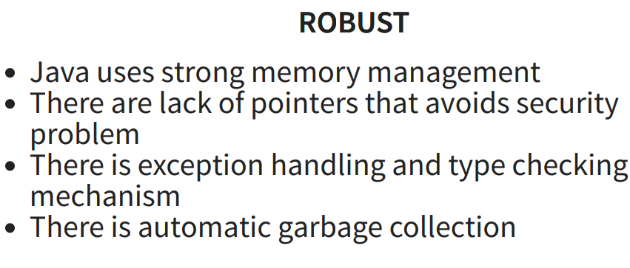
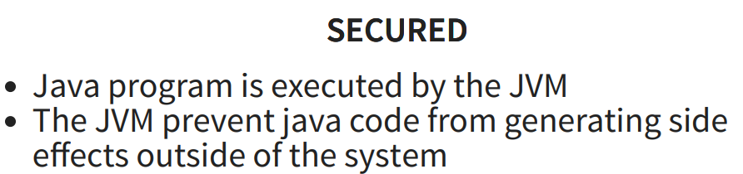
CHECKLIST – ABOUT JAVA
JAVA FUNDAMENTALS

Slide 13
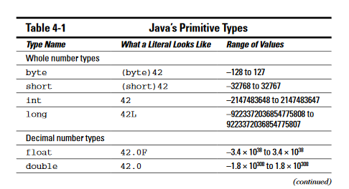
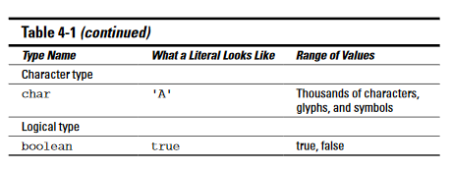
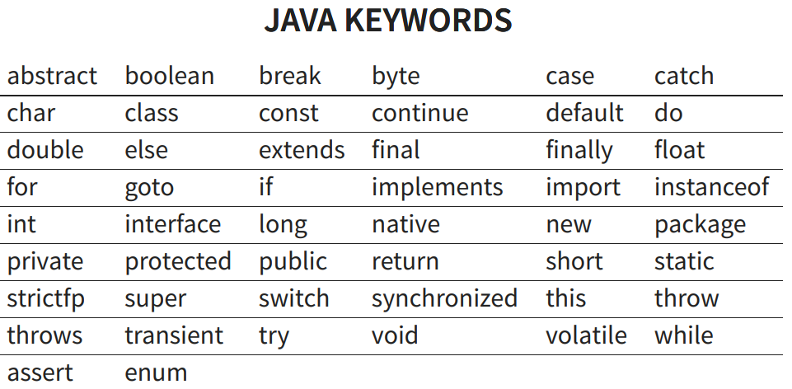
CHECKLIST – Primitive Types & Keywords
JAVA FUNDAMENTALS

Slide 14
CHECKLIST – VARIABLES
JAVA FUNDAMENTALS
A variable is a placeholder. You can stick a number like 50.22 into a variable. After
you place a number in the variable, you can change your mind and put a different number into the variable.
Of course, when you put a new number in a variable, the old number is no longer there. If you didn’t save the old number somewhere else, the old number is gone.
Now you need some terminology. The thing stored in a variable is a value.
A variable’s value can change during the run of a program (when Jack gives you a million bucks, for instance).
The value that’s stored in a variable isn’t necessarily a number. (For instance, you can create a variable that always stores a letter.)
The kind of value that’s stored in a variable is a variable’s type.

Slide 15
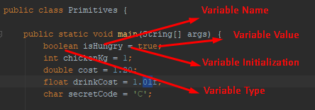
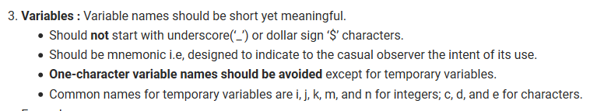
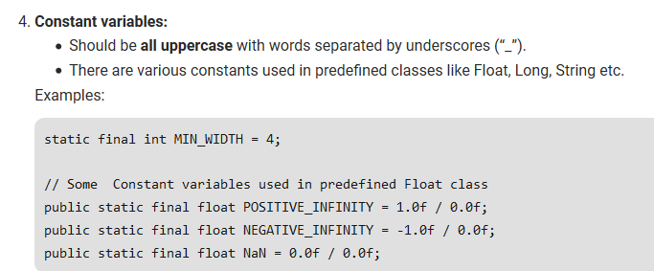
CHECKLIST – VARIABLES
JAVA FUNDAMENTALS
* Start with lower case for variable name*

Slide 16
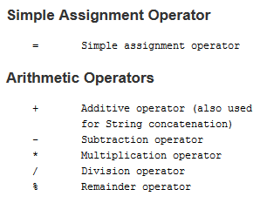
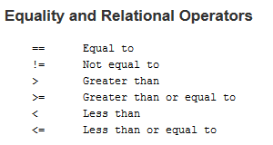

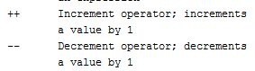
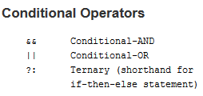
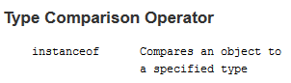
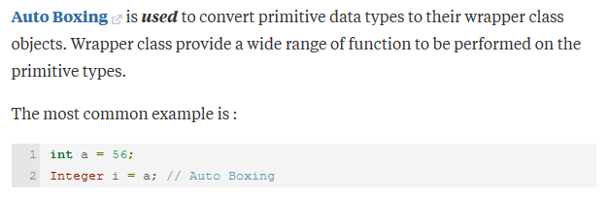
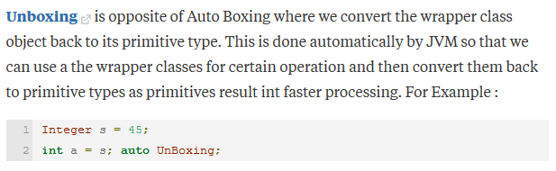
CHECKLIST – OPERATORS && Boxing Conversion
JAVA FUNDAMENTALS

Slide 17
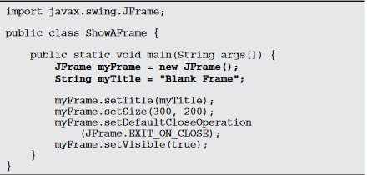
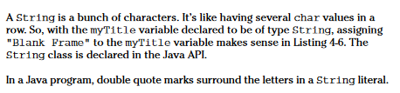
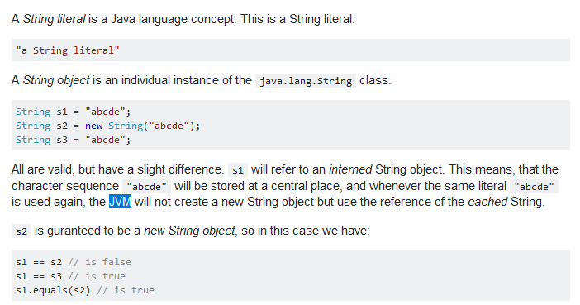
CHECKLIST – STRING
JAVA FUNDAMENTALS

Slide 18
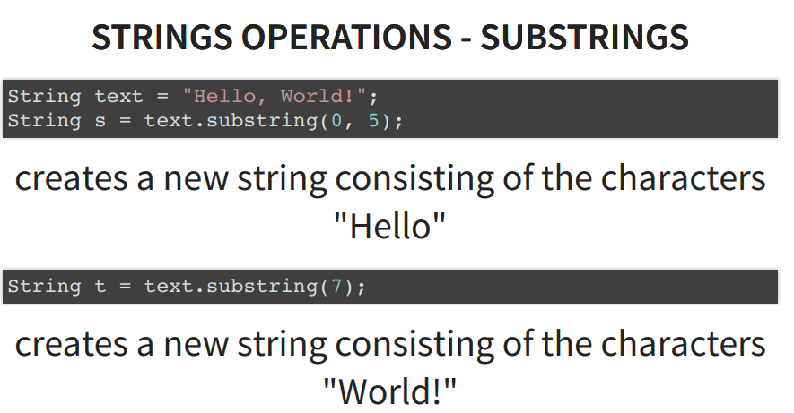
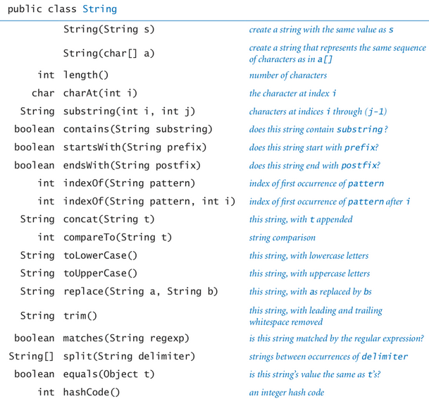
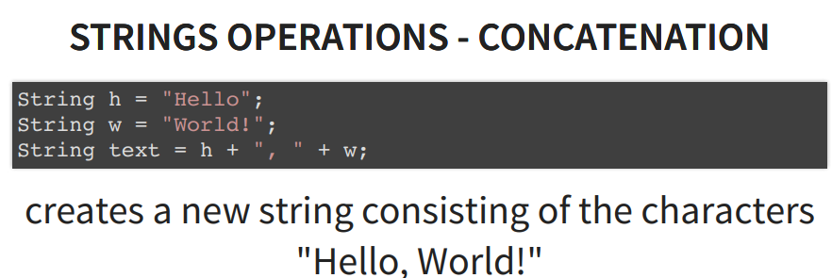
CHECKLIST – STRING
JAVA FUNDAMENTALS

Slide 19
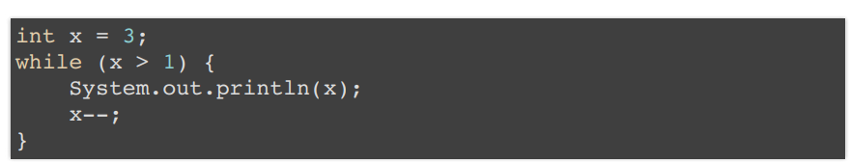
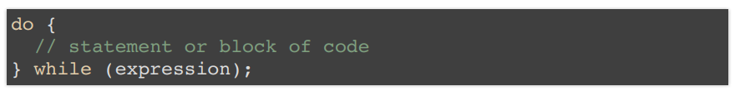
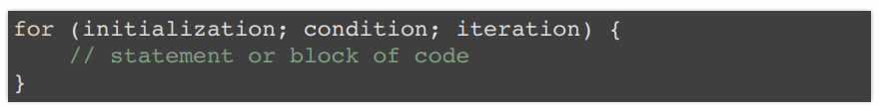
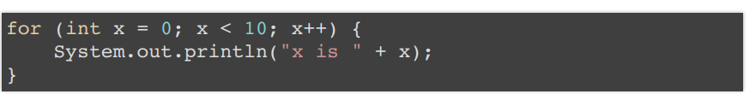
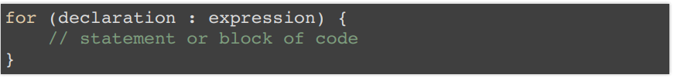
CHECKLIST – LOOPS
JAVA FUNDAMENTALS

Slide 20
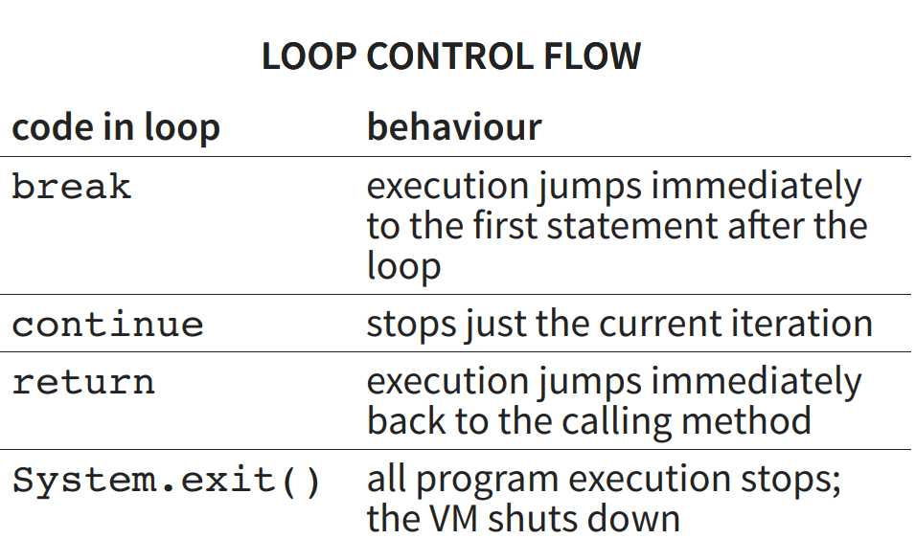
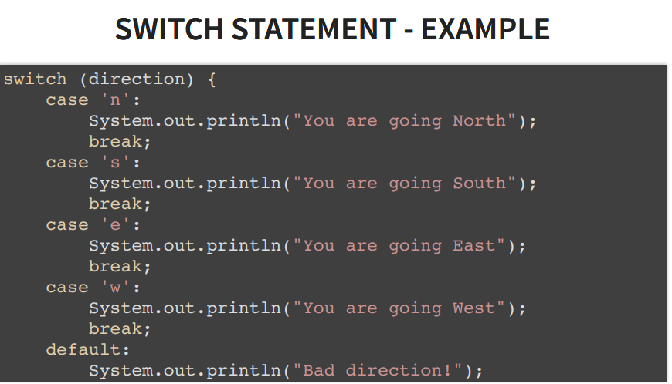
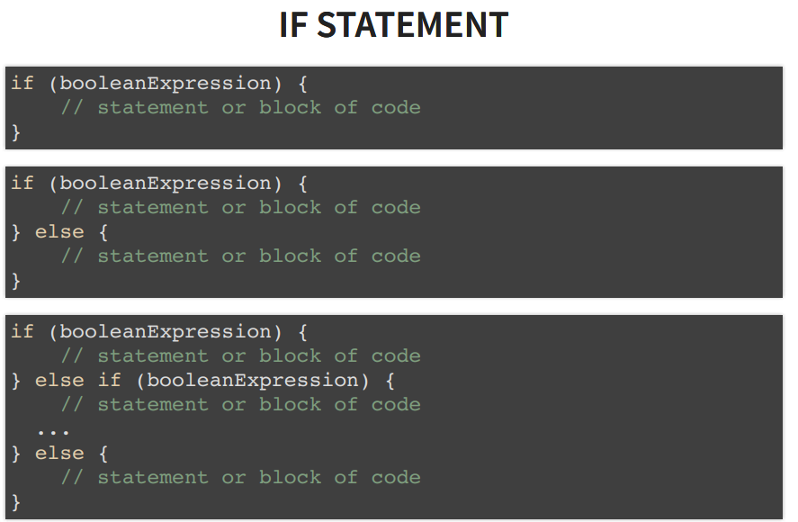
CHECKLIST – LOOPS && IF && SWITCH
JAVA FUNDAMENTALS

Slide 21
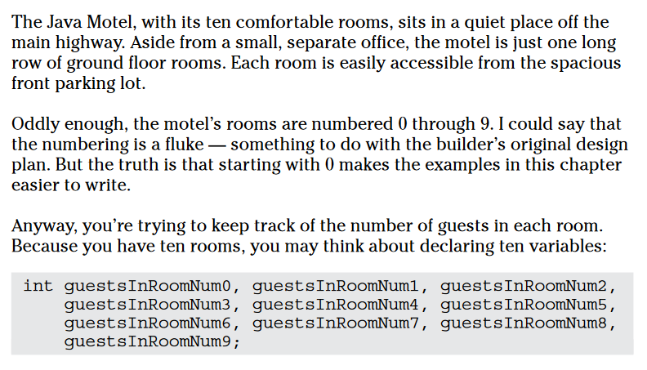
CHECKLIST – ARRAYS
JAVA FUNDAMENTALS

Slide 22
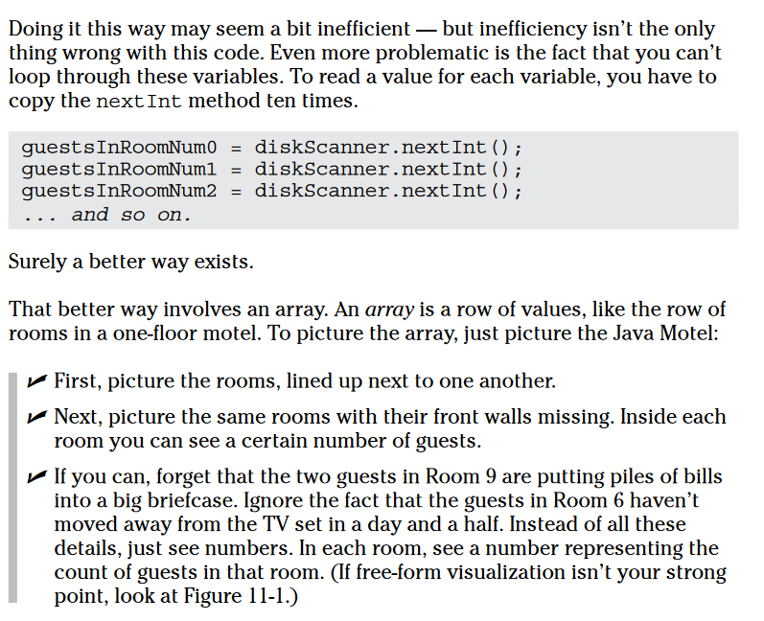
CHECKLIST – ARRAYS
JAVA FUNDAMENTALS

Slide 23
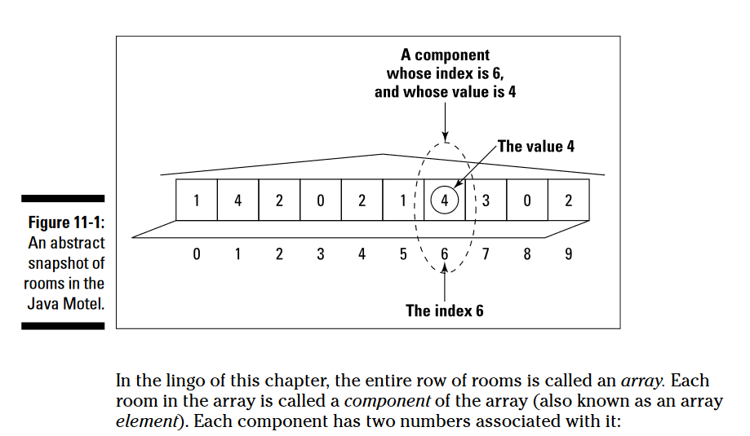
CHECKLIST – ARRAYS
JAVA FUNDAMENTALS

Slide 24
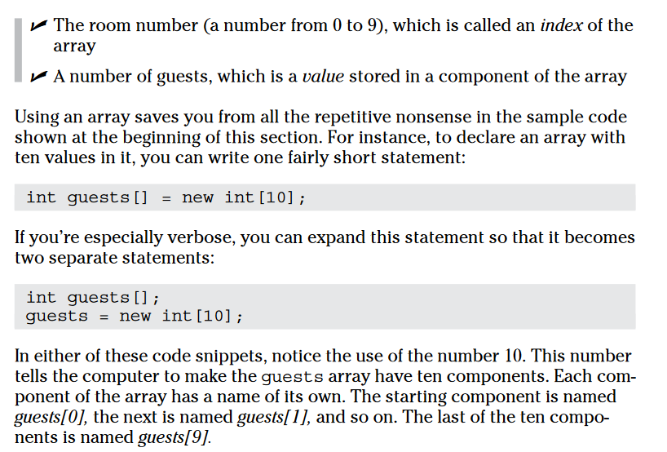
CHECKLIST – ARRAYS
JAVA FUNDAMENTALS

Slide 25

CHECKLIST – ARRAYS
JAVA FUNDAMENTALS

Slide 26

CHECKLIST – ARRAYS
JAVA FUNDAMENTALS

Slide 27





CHECKLIST – ARRAYS
JAVA FUNDAMENTALS

Slide 28





CHECKLIST – ARRAYS
JAVA FUNDAMENTALS

Slide 29



CHECKLIST – OBJECT-ORIENTED PROGRAMMING
JAVA FUNDAMENTALS

Slide 30


CHECKLIST – OBJECT-ORIENTED PROGRAMMING
JAVA FUNDAMENTALS

Slide 31

CHECKLIST – OBJECT-ORIENTED PROGRAMMING
JAVA FUNDAMENTALS

Slide 32


CHECKLIST – OBJECT-ORIENTED PROGRAMMING
JAVA FUNDAMENTALS

Slide 33



CHECKLIST – Variable Scopes
JAVA FUNDAMENTALS

Slide 34


CHECKLIST – Variable Scopes
JAVA FUNDAMENTALS
Instance variable in java is used by Objects to store their states. Variables which are defined without the STATIC keyword and are Outside any method declaration are Object specific and are known as instance variables. They are called so because their values are instance specific and are not shared among instances.

Slide 35



CHECKLIST – Variable Scopes
JAVA FUNDAMENTALS
A local variable in Java is a variable that’s declared within the body of a method. Then you can use the variable only within that method. Other methods in the class aren’t even aware that the variable exists.
You may also declare local variables within blocks of code marked by braces. For example:

Slide 36


CHECKLIST – Variable Scopes
JAVA FUNDAMENTALS
These variables are defined inside blocks of code (between { and }) and can be used while the block is executed; typical blocks of code are for, while, initialization block.

Slide 37


CHECKLIST – Member Variables
JAVA FUNDAMENTALS
Member variables in a class — called fields.
Variables in a method or block of code — called local variables.
Variables in method declarations – called parameters.

Slide 38


CHECKLIST – Constructors
JAVA FUNDAMENTALS

Slide 39

CHECKLIST – Methods
JAVA FUNDAMENTALS
Methods are fundamental building blocks of Java programs. Each Java method is a collection of statements that are grouped together to perform an operation.
Method declarations have six components, in order: 1. Modifier - it defines the access type of the method and it is optional to use. 2. Return type - method may return a value. 3. Method name. 4. Parameter list in parenthesis - it is the type, order, and number of parameters of a method. 5. Method body - defines what the method does with the statements.

Slide 40


CHECKLIST – Packages && Imports
JAVA FUNDAMENTALS
Packages are used in Java in order
to prevent naming conflicts
to control access
to make searching/locating and usage of classes, interfaces, enumerations and annotations easier, etc
If you want to use a class from a package, you can refer to it by its full name (package name plus class name).
For example, java.util.Scanner refers to the Scanner class in the java.util package:

Slide 41


CHECKLIST – Static Fields, Methods and Imports
JAVA FUNDAMENTALS

Slide 42

CHECKLIST – Static Fields, Methods and Imports
JAVA FUNDAMENTALS

Slide 43

CHECKLIST – Static Fields, Methods and Imports
JAVA FUNDAMENTALS

Slide 44


CHECKLIST – Static Fields, Methods and Imports
JAVA FUNDAMENTALS

Slide 45


CHECKLIST – Static Fields, Methods and Imports
JAVA FUNDAMENTALS

Slide 46

CHECKLIST – Static Fields, Methods and Imports
JAVA FUNDAMENTALS

Slide 47





CHECKLIST –
JAVA FUNDAMENTALS

Slide 48

CHECKLIST – Regular Expression (Regex)
JAVA FUNDAMENTALS
A regular expression defines a search pattern for strings
The search pattern can be anything from a simple character, a fixed string or a complex expression containing special characters describing the pattern
The pattern defined by the regex may match one or several times or not at all for a given string
Regular expressions can be used to search, edit and manipulate text

Slide 49

CHECKLIST – Regular Expression (Regex)
JAVA FUNDAMENTALS

